Slide 1

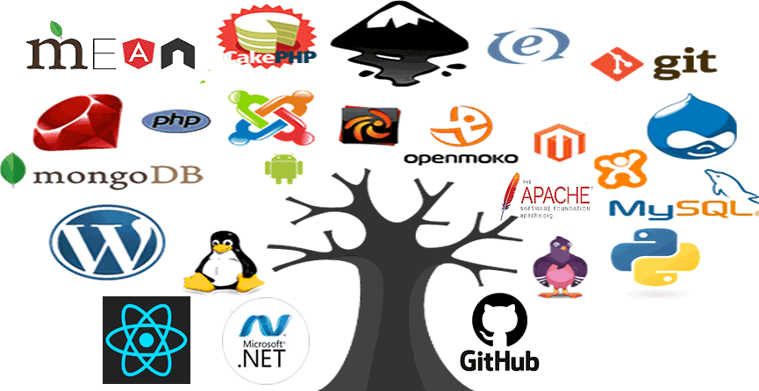
Open Source
Solutions for SMEs
Software Development
Focus: Development
Scalable Development
Collaboration
Remote
Community
Software redistribution

Slide 2

Open Source
Solutions for SMEs
Software Development
… and yet again!
LeROIFOPESON
Information Systems & Technology Consultant
Linux Professional Institute (LPI-2) Certified
Used MS/PC DOS, Windows 3, 95, 98, XP & 7
(XP was my favorite)
Switched to Linux
Abimbola Adefope
Speaker

Slide 3
Open Source
Solutions for SMEs
Assignment Review
Software Development
Any Issues arising from:
Repeat the deployment demonstrated for Dollibarr or any other software, on your own computer and explore the software.
Download installation software, for your operating system, from Bitnami Stacks.
Download and install Apache OpenOffice or LibreOffice on your own computer for and explore it.
Go to the relevant website to download the installation files.
3. Find, install & explore any open source software which you may find a useful alternative to a proprietary one you may already have.
4. Uninstall all software after exploration, if no longer needed.
Practice remote access with AnyDesk on your own computer systems or with a colleague at a different location.

Slide 4
Open Source
Solutions for SMEs
Open Source Software Development
Software Development
Project Types:
A developer releases the source code for a working project to the public or developer community for contributions
Linus Torvalds: Linux
The source code for a pre-existing proprietary project is released to the public for diverse application and extension (e.g. through plug-ins)
Google: Chromium
Mozilla: Firefox
An existing open source project may be forked from a repository and developed further into another open source project
OpenOffice.Org => LibreOffice
Debian Linux => Ubuntu Linux et al

Slide 5
Open Source
Solutions for SMEs
Open Source Software Development
Software Development
Project Collaboration:
A community quickly forms around a project comprising the development team and users – Github, Bitbucket.
The continuous exchange of feedback and debugging of the code is key to a successful project - emails, forums, chats, bug trackers etc.
The project source code is constantly made available to everyone through a repository online, for remote accessibility from any location – GitHub.
A strict version control is kept of the different stages of the project during the development process – Git.
Continuous integration & debugging tools are used to automate testing of the project – Jenkins, GitLab
Project s are financed through donations from users, crowd funding and corporate sponsors – Red Hat => Fedora, Microsoft => .NET, PWA Builder

Slide 6
Open Source
Solutions for SMEs
Open Source Software Development
Software Development
Project Sustainability and Profitability:
A successful project is one that has become widely adopted and users are willing to pay for additional targeted enhancements and support.
Training, consulting & support services
Using a project to provide IaaS & SaaS online solutions – Linux , Apache
Dual licensing or Open Core – Software is release both in open source unsupported community version and also in a proprietary supported version for enterprise level usage – MySQL, MongoDB
Providing optional proprietary features.
Selling modified versions of open software which have a permissive license
Web application development for multi-device software solutions - PWA Builder => Mobile Apps

Slide 7

Open Source
Solutions for SMEs
From the first session
Open Source in Software Development
Open source tools are the primary tools for developing for the web and for building mobile apps.
Systems software development is done with C, C++ and other high level programming languages, sometimes with Python or Perl.
Some popular open source tools for development:
Languages: Javascript, PHP, Python, Rerl, Ruby, Android
Frameworks/Libraries: Angular, NodeJS, Ruby on Rails, React, Vue, Bootstrap
Tools: Git, Docker, Sublime Text editor
Databases: MongoDB, MySQL, PostgreSQL
CMS: WordPress, Drupal, Joomla
Development Stacks: AMP, APP, MEAN, MERN

Slide 8
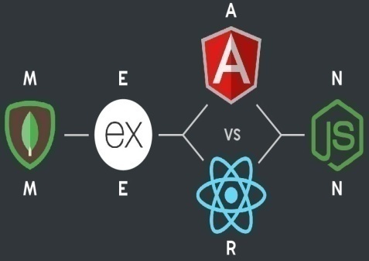

Open Source
Solutions for SMEs
From the first session
Open Source Software Development Stacks
A Stack refers to a core set of tools which are required to develop a fully functional software application.
Examples:
AMP Stack – Apache, MySQL, PHP (Python or Perl)
APP Stack : Apache, PostgreSQL, PHP (Python or Perl)
MEAN Stack: MongoDB, ExpressJS, Angular, NodeJS
MERN Stack: MongoDB, ExpressJS, React, NodeJS
CMS Stacks: WordPress, Drupal or Joomla + MySQL
AMP & APP are commonly referred to as LAMP, MAMP or WAMP stacks depending on the underlying operating system, Linux, macOS or Microsoft Windows, in development.

Slide 9
Open Source
Solutions for SMEs
Open Source Software Development
Software Development
DEMO: The MEAN Stack
A. New Installation
Download the version of Bitnami MEAN Stack from bitnami.com/stack/mean/installer for your operating system and install it.
Give MongoDB user root a password
Deselect cloud deployment option for local installation only
Start all servers
Enable MEAN Stack environment with use_meanstack command at the command line in the stack folder
This installs NodeJS and MongoDB in on the computer.
[FOR THIS DEMO ONLY] Edit mongodb.conf in the mongodb folder to
disable auth => #auth and enable #noauth => noauth

Slide 10
Open Source
Solutions for SMEs
Open Source Software Development
Software Development
DEMO: The MEAN Stack
New Installation
Angular is added by following the instructions at angular.io/cli
npm install -g @angular/cli
Create a fresh project with:
ng new projectFrontend
cd projectFrontend (Source code is in this folder )
c. Start local angular server with: ng serve
5. Instructions for installing ExpressJS are at expressjs.com.
Use npx express-generator to create a fresh starter backend.
Change directory to the backend directory:
cd projectBackend
Run npm start to execute the backend server software

Slide 11
Open Source
Solutions for SMEs
Open Source Software Development
Software Development
DEMO: The MEAN Stack
B. Installation: Clone Pre-Existing code
Create separate folders for frontend & backend source code.
Enable MEAN Stack environment by running
use_meanstack - from the command line in the stack folder
In frontend folder:
npm install - to install the cloned source code.
ng serve –o - to run the application
In backend folder:
npm install - to install the cloned source code.
npm start – to run the application

Slide 12

Open Source
Solutions for SMEs
Open Source Software Development
Software Development
DEMO: The MEAN Stack
C. Source Code Version Control & Collaboration – Git
Download Git Distributed Version Control System, for your computer OS, from git-scm.com & install the software on your system.
Creates a Git repository on local computer which can link with a remote Git repository
Open the sample source code frontend folder in a bash terminal shell and enter the following commands at the prompt followed by the return key:
git init - To initialize local Git version control
git status - To display status of files in the directory
touch .gitignore - To create an exclusions list file
Edit the .gitignore file with any file editor to include file patterns for files & directories that should not be tracked by Git.

Slide 13
Open Source
Solutions for SMEs
Open Source Software Development
Software Development
DEMO: The MEAN Stack
C. Source Code Version Control & Collaboration – Git
4. .gitignore should include, among others:
node_modules/
5. Run the following to ensure that only the desired files are being tracked:
echo “ Code name & other information” >> README.md
git status - node_modules directory and any other files listed in .gitignore should not be listed
git add . - To add files listed to the local Git repository
git status - Shows files to be committed
git commit – m “Insert name of commit” - To prepare code for staging in a remote repository.
6. Step 5. may be repeated as many times as there are notable changes made to the contents of the files being tracked.

Slide 14

Open Source
Solutions for SMEs
Open Source Software Development
Software Development
DEMO: The MEAN Stack
C. Source Code Version Control & Collaboration – Git & Github
To make the software available to collaborators and other remote users,
the commits have to be pushed to an repository online, like Github.
Create a Github account and a repository at github.com
At local command-line run the following commands:
git remote add origin https://github.com/username/repository-name.git
git branch –M main
git push –u origin main
10. Enter username and password for the Github account when prompted.

Slide 15
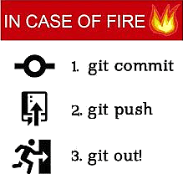
Open Source
Solutions for SMEs
Open Source Software Development
Software Development
DEMO: The MEAN Stack
C. Source Code Version Control & Collaboration – Git & Github
If successful, repeat Steps 3 to 10 for the backend source code.

Slide 16
Open Source
Solutions for SMEs
Open Source Software Development
Software Development
Assignment:
Download and install the Bitnami MEAN Stack on your local computer.
Install all the Angular & ExpressJS components.
Go to https://github.com/opensmes to download or clone copies of the frontend and backend source code.
Use these to reproduce the open source application on your local computer

Slide 17

Open Source
Solutions for SMEs
Software Development
Next session: Deployment online
PREPARING & DEPLOYING THE MEAN STACK APPLICATION ON THE WEB
Thank you for listening.

